Slide 1
Balanced and Unbalanced Forces

Slide 2
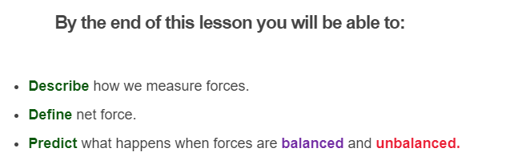
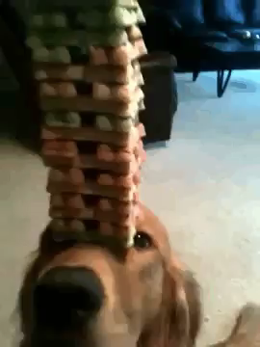

Slide 3
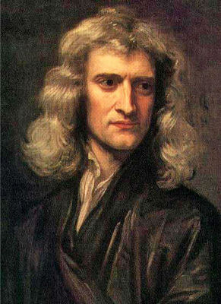
The harder you push on something, the bigger the force you apply...
The size of a force can be measured using various techniques.
We measure force in newtons, which have the special symbol N. This symbol appears in calculations involving forces.
The Newton is named after Sir Isaac Newton, who helped to develop our understanding of forces and motion.

Slide 4
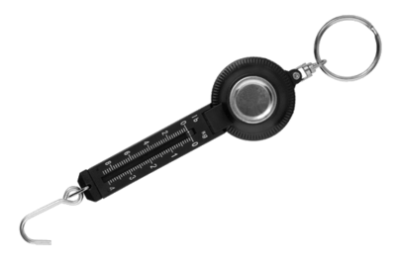
One way to measure the size of a force is with a force meter, also known as a spring balance.
Inside the meter is a spring. When you pull on the hook at the end, or hang a weight from it, the spring stretches. The further it stretches, the more force you're applying!

Slide 5
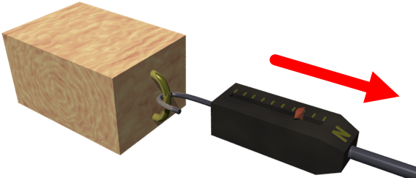
The force meter has a scale, which shows the size of the force in newtons.
Let's look at how it's used with an example.
Imagine you take a block of wood and attach a force meter to it. Then hold the meter and use it to drag the block across a horizontal floor.

Slide 6
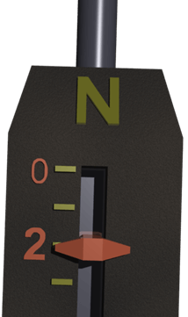
If we look closely at the meter, we see that it reads 2 N.
That means you're applying 2 newtons of force to move the block across the floor.

Slide 7
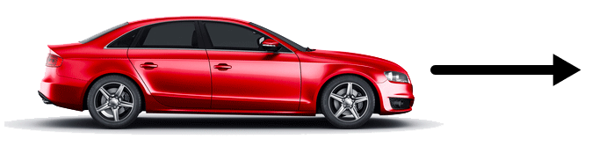
Forces have both a size and a direction.
In the previous lesson we looked at how we draw forces with arrows. This is an easy way to see which direction a force is acting in.

Slide 8


Lets look at an example.
These two arrows are facing the same way. This means that the forces they represent will point in the same direction.
Meanwhile, these arrows are pointing opposite ways. This means that the forces point in opposite directions.

Slide 9
There are lots of forces around us that are invisible!
There are a few types of forces that we need to know about. We will learn more about these later, but here is a quick introduction to a few important terms:
Gravity force: | This is a force caused by very large objects (like Earth or the sun) which pulls objects toward them.
Support (normal)* force: | This is an upwards force that a surface exerts on an object which is resting on it.
Thrust force: | This is a force which pushes an object forwards. Engines generate thrust forces.
Resistance force: | This is a force which acts in the opposite direction to the movement of an object. This includes friction and air resistance.

Slide 10

Forces are balanced when they are the same size and act in the opposite direction.
For example, when a man sits on a chair, you don't expect him to sink to the floor or fly into the air. The man is not moving because the forces balance out.
In scientific terms, this means there is no net force acting on the man. A net force would cause a change in motion.

Slide 11
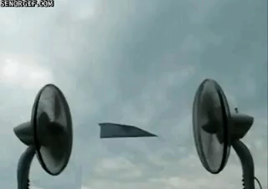
The net force is the sum of all of the forces acting on an object.
When an object isn't moving, like the paper plane below, it doesn't mean there are no forces acting on it. It actually means that the overall or net force is 0.

Slide 12
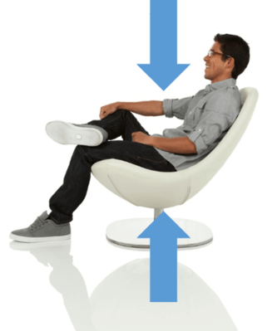
There is a downward force acting on the man due to gravity, so there must be another force to balance it and keep him at rest.
He doesn't move because the seat provides a support force that is equal to the gravity force, but acts in the opposite direction. The two forces balance each other. This means no net force acts on the man.

Slide 13
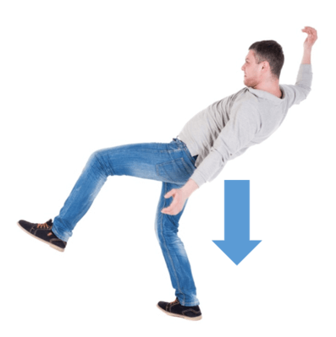
Remember, forces are only balanced when they are the same size and act in the opposite direction.
If the chair were to disappear from under the man, there would be no support force to keep him at rest. This would mean that only gravity force acts on him.
The net force is now unbalanced, which causes a change in motion. Rather than being stationary, the man accelerates and falls to the ground.

Slide 14
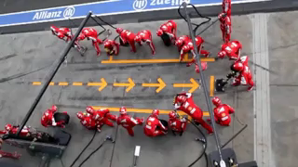
An object has a change in motion when an unbalanced net force acts on it.
This means that the object could speed up or slow down. They can also stop objects from moving!
When car brakes are applied it causes an unbalanced net force which points in the opposite direction to which the car is moving. This makes the car stop.

Slide 15
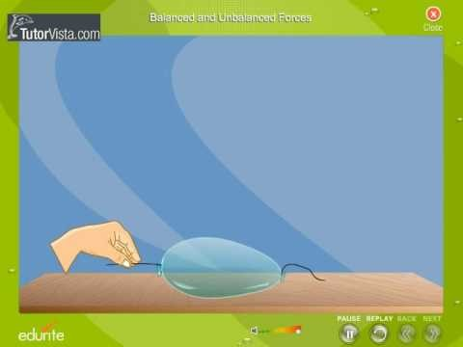

Slide 16
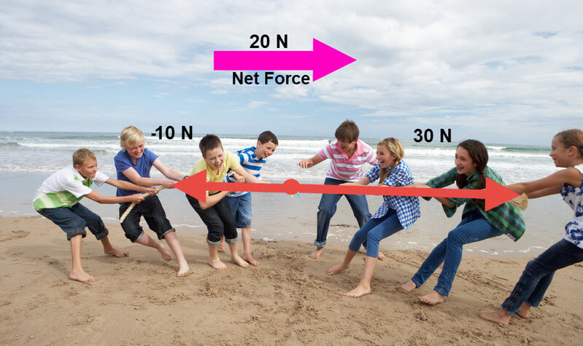
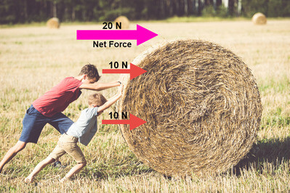
How do we calculate net force?
We calculate net force by adding together all of the forces acting on an object. When forces act in opposite directions, one of them will always be written as a negative force.
This doesn't mean it is negative in strength, it just means one of the forces is acting in an opposite direction to the other.
Check out the two examples of net force below!

Slide 17
